Slide 1
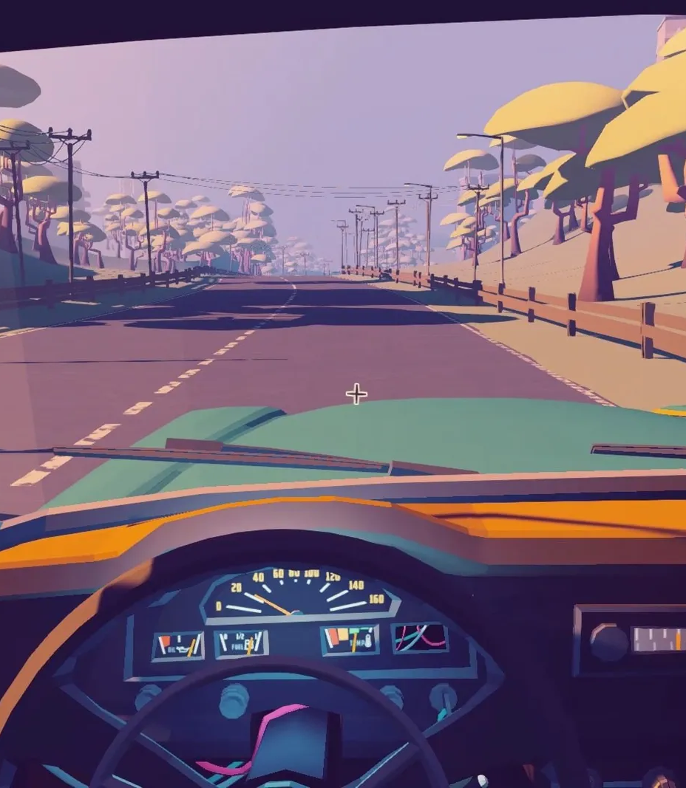
ROAD TRIP BOarD game
Nirmal Reddy
Sathish
Daniel
Niharika

Slide 2
Agenda
Introduction
Mapping
Technical overview
Demo of game
Conclusion

Slide 3

What is road trip game?
Road trip game is a board game which has a maximum of four players. this game will be played by using dice. You can even set the number of traps the minimum being nine. It is bidirectional game.

Slide 4
How to play?
Roll the dice
Progress
Traps and bonuses
Roadblocks and gas stations
Weather conditions
destination

Slide 5
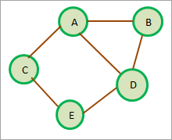
GRAPH
In the road trip game, the graph can be used to represent the different spaces on the board and the paths that players can take between those spaces. Each space on the board is represented as a vertex (or node) in the graph, and the paths between spaces are represented as edges in the graph.

Slide 6
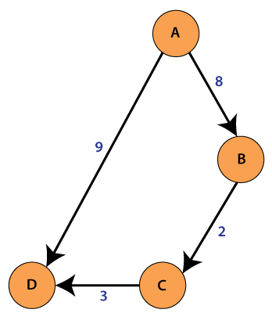
DIGRAPH
A directed graph with vertices numbered 0 through V–1 is represented by the Digraph class.
It enables the two basic actions of adding an edge to the digraph and iterating through all of the vertices that are close to a certain vertex.
Additionally, it has methods for retrieving a vertex's indegree or outdegree, the number of edges (E) and vertices (V) in a digraph, as well as the reverse digraph.
Self-loops and parallel edges are both acceptable.
The game uses directed graphs to map out the spaces on the board and the paths that players can take

Slide 7
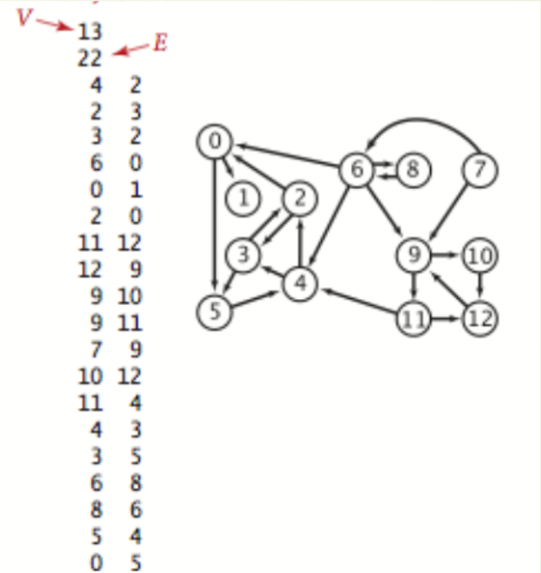
MAPPING
The road_trip_table.txt file contains the edges of the directed graph that represents the road trip game. Each line in the file represents an edge in the graph, with the first number representing the starting vertex (or source) of the edge and the second number representing the ending vertex (or destination) of the edge.

Slide 8
Technical overview
Data Structure
The use of directed graph data structures in the project, including the Digraph class from the edu.princeton.cs.algs4 library.
The game reads in a node table from a text file to create the directed graph, and how this graph represents the spaces and paths on the board.

Slide 9
User interface
This describes the user interface for the game, including how players input the number of players and traps/bonuses, and how the game displays the current player positions, traps/bonuses encountered, and fuel/weather conditions.
Now the game automatically plays and how the game ends either when all players reach the destination or run out of fuel.

Slide 10
Algorithms
The algorithms are used to implement the game's mechanics, such as random number generation, player movement, and collision detection.
The game uses breadth-first search algorithms to check for traps, bonuses, fuel stations, road blocks and weather conditions.

Slide 11
DEMO OF GAME
This demo gives the sample view of the road trip game that we have designed.
Demonstrating how to input the number of players and traps/bonuses using the Scanner class.
start the game by running the main class in the IDE or command line.

Slide 12
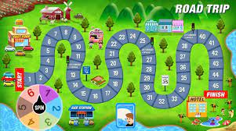

Slide 13
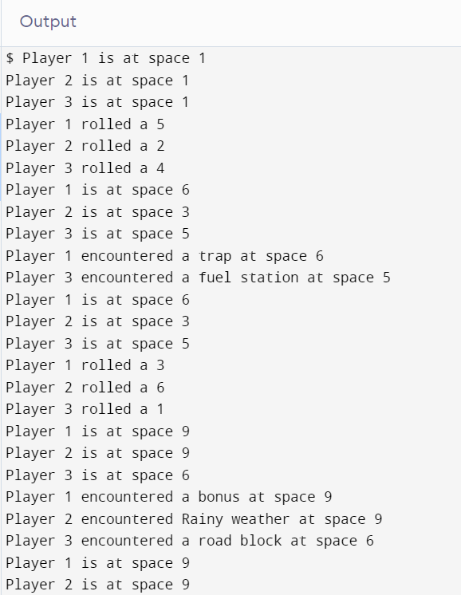
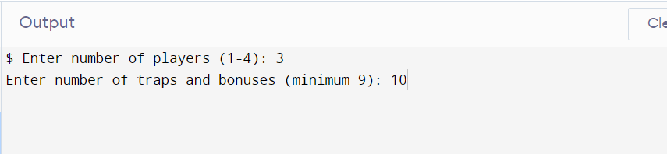
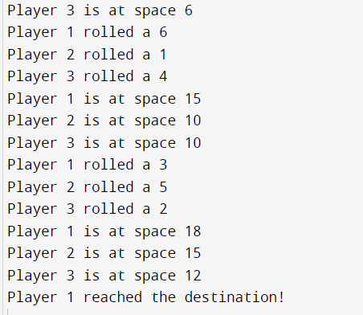

Slide 14
FUTURE WORK
The future improvements for the project, such as adding sound effects, providing statistics at the end of the game, and updating the user interface
The project can be extended to other similar games or applications that use directed graph data structures.

Slide 15
Conclusion
What is the game about ?
What are graphs and digraphs ?
Technical overview
Live instance of the game
Future Updates

Slide 16
Thank you

